Slide 1
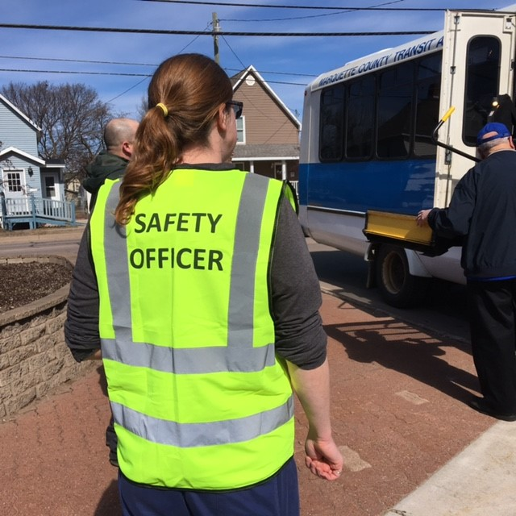

Region 8
COVID Reflections

Slide 2
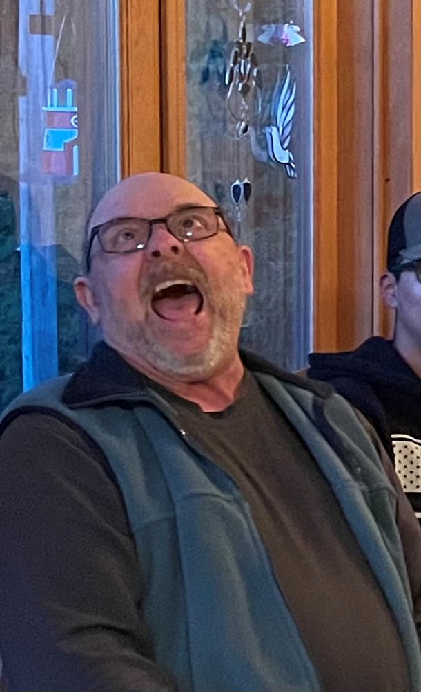
HELP!!!!!!!

Slide 3
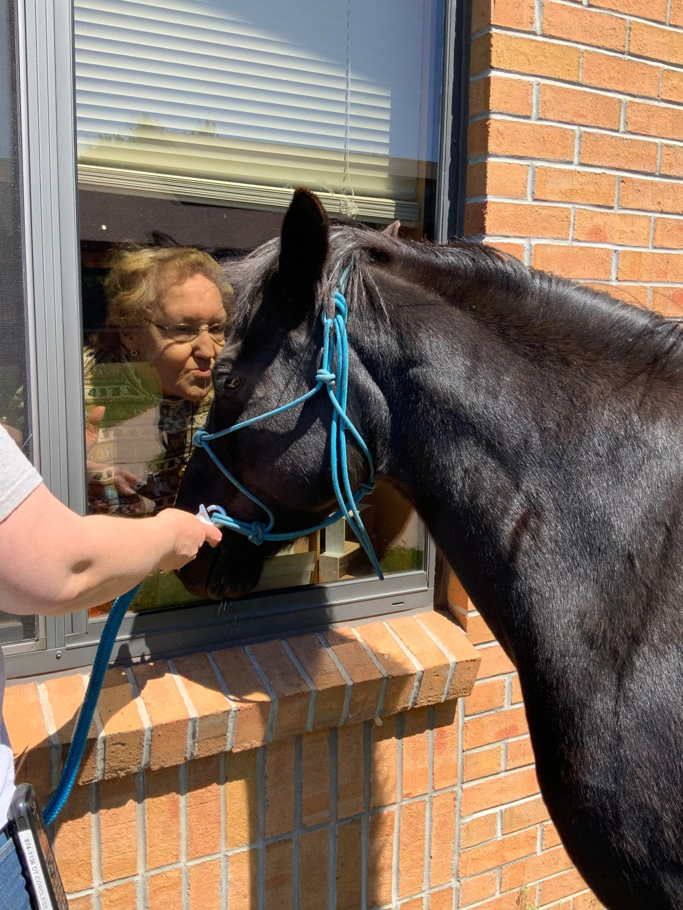
Iron County Medical Care Facility
“Window Visit”

Slide 4


Slide 5
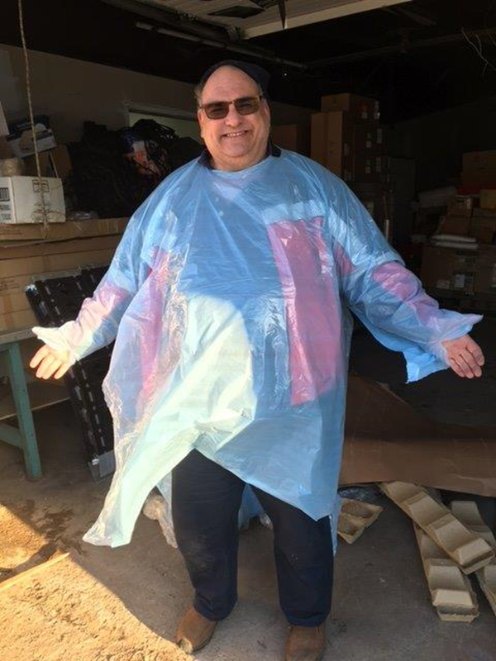
Bob Berbohm
Ed Unger, Region 8 HCC Coordinator

Slide 6
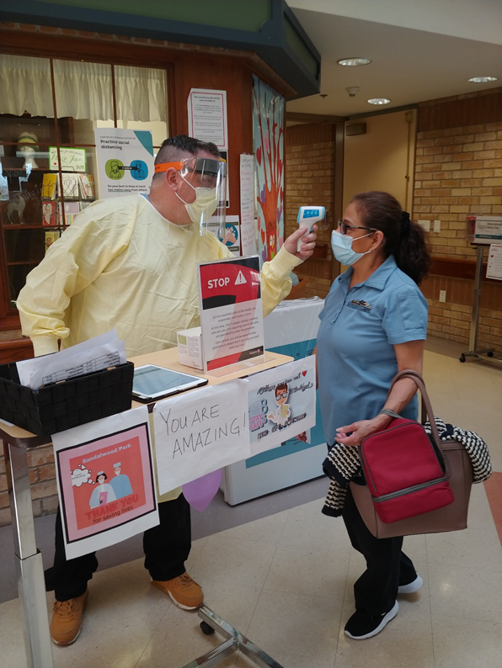

Slide 7
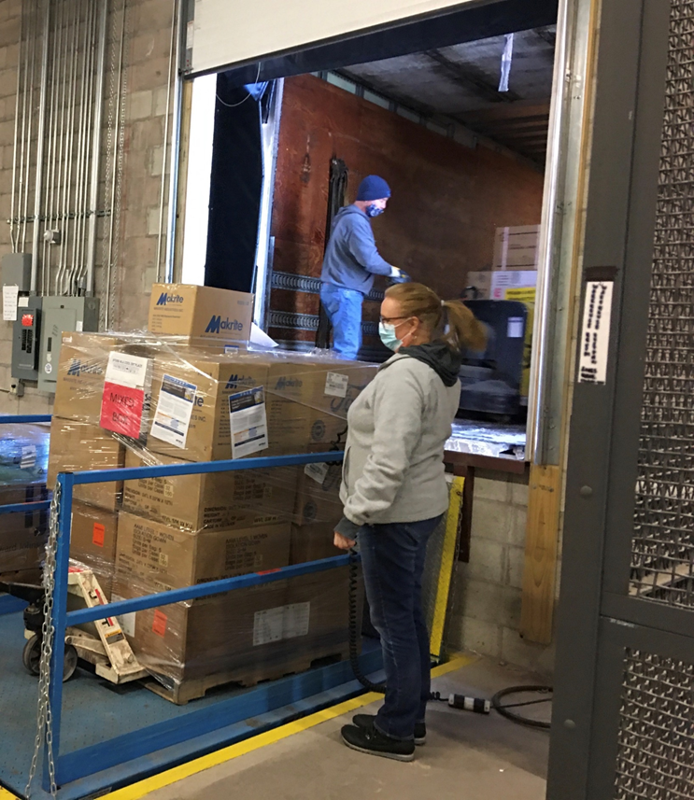
Teresa Schwalbach, Marquette Co Emergency Manager

Slide 8
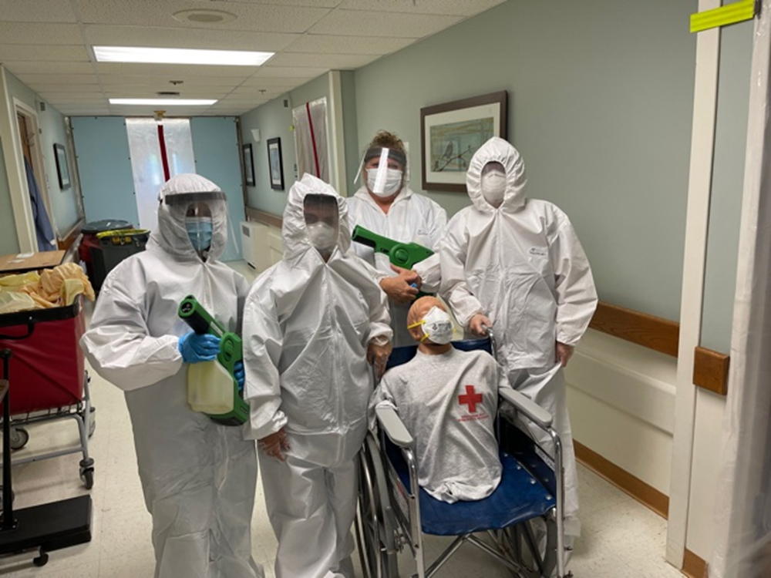
Eastwood Nursing Center
Internal COVID Evacuation Exercise

Slide 9
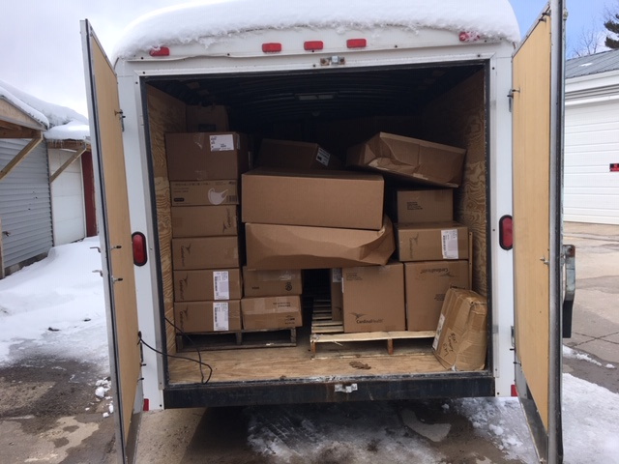
PPE Delivery to Regional Partners

Slide 10
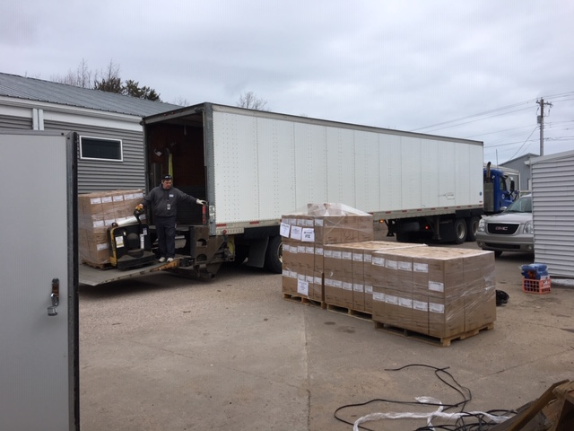
State PPE Delivery

Slide 11
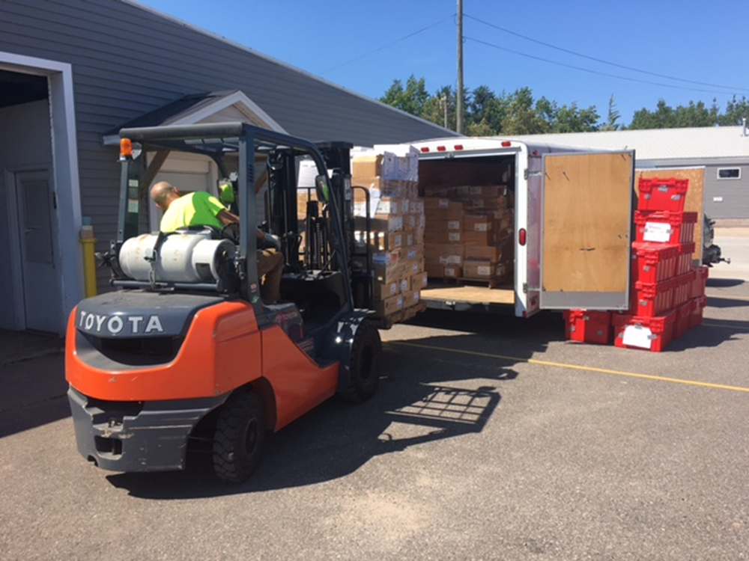
Region 8 Pharmaceutical Cache

Slide 12
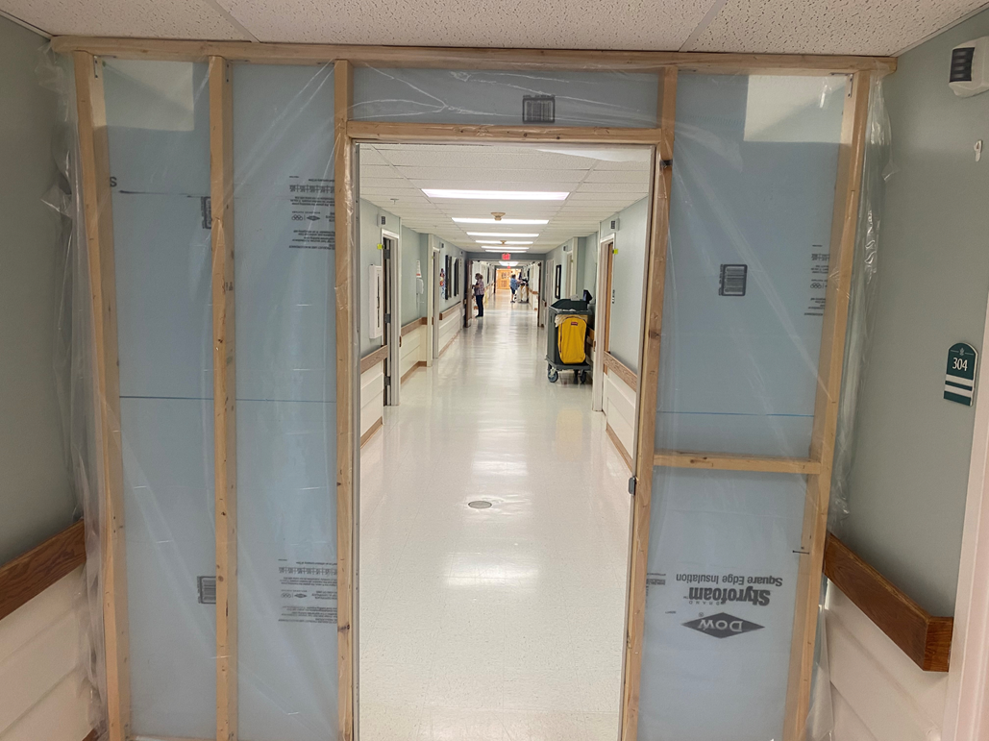
COVID Temporary Barrier
Eastwood Nursing Center

Slide 13
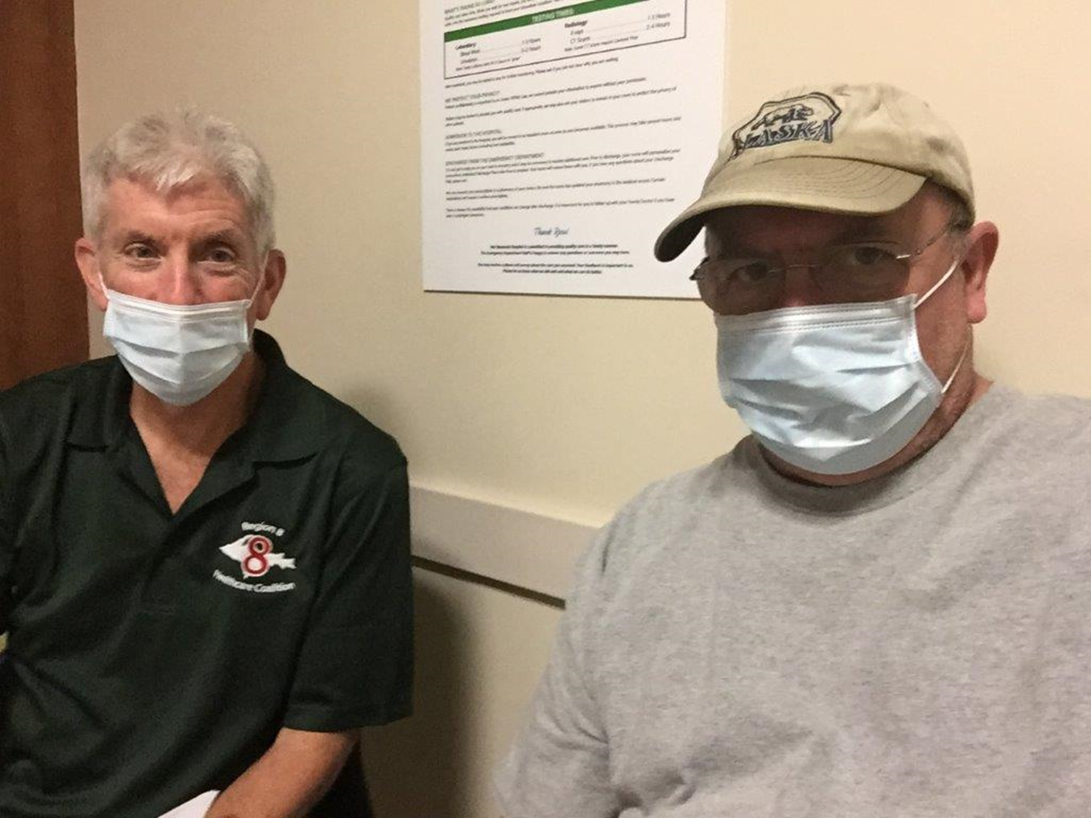
Dr. Don Edwards – Region 8 Medical Director
Gary Gustafson – Region 8 Assistant Coordinator

Slide 14
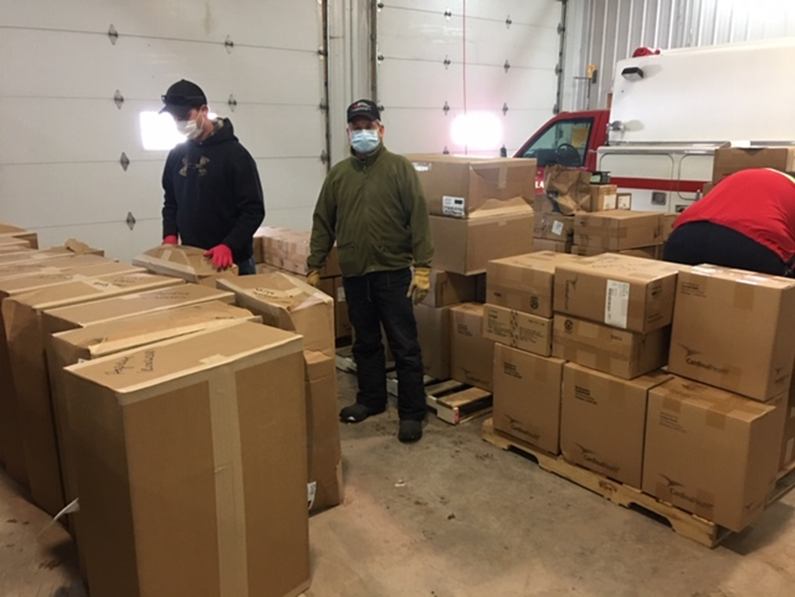
Mike Kocher – Iron County EM
Mass City PPE HUB

Slide 15
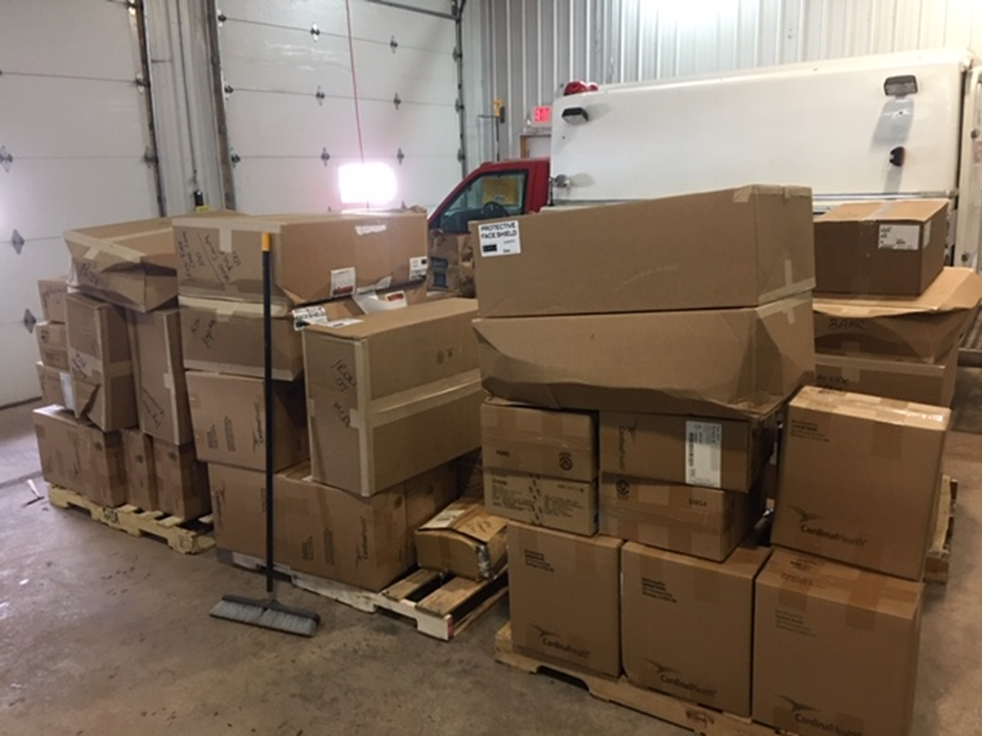
Incident Command Team
Eastwood Nursing Center
Full Scale Evacuation Exercise

Slide 16
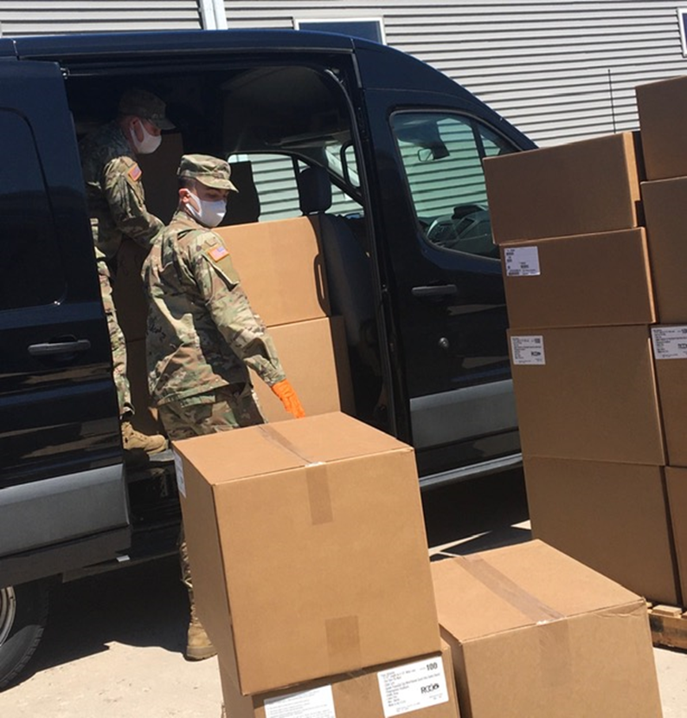
National Guard Supply Pickup –Region 8

Slide 17
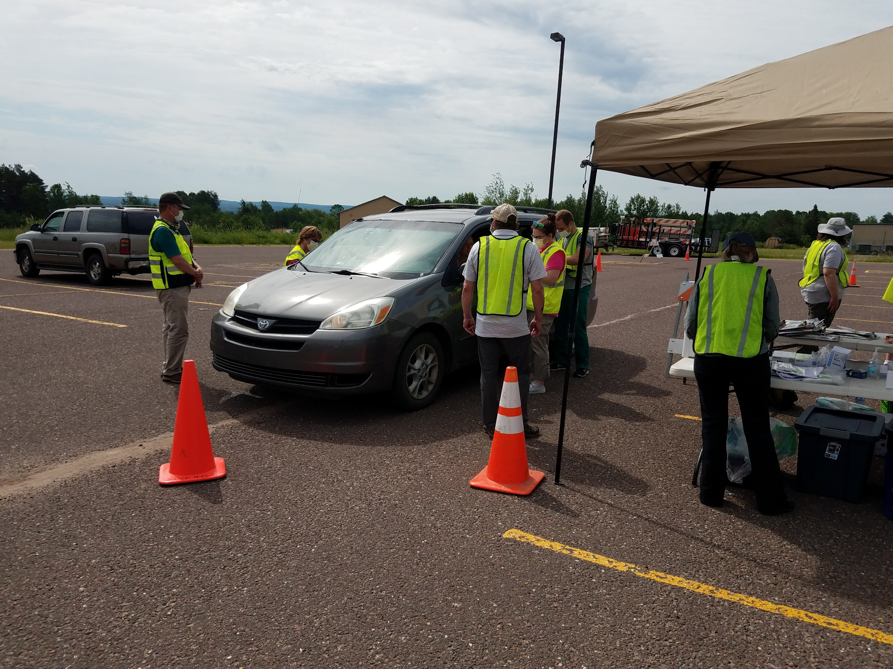
WUPHD

Slide 18
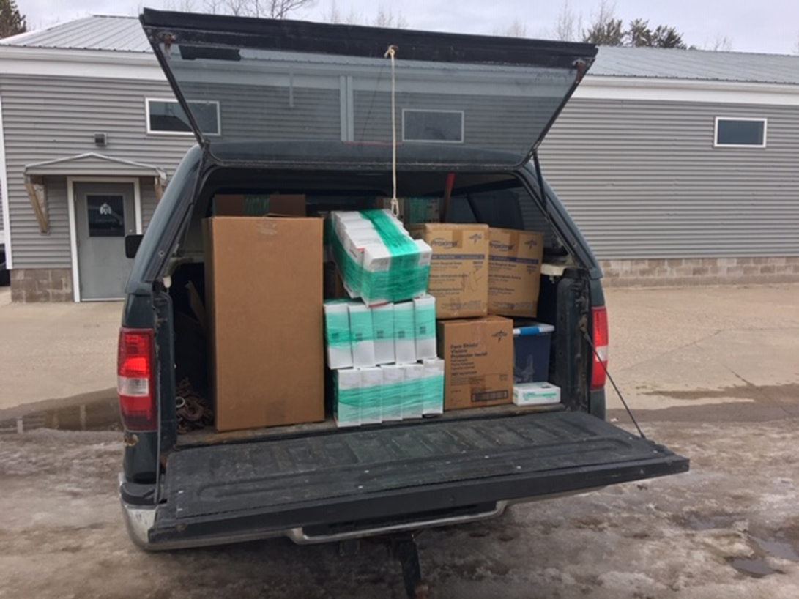
Ed’s Pickup – Regional Supply Delivery

Slide 19
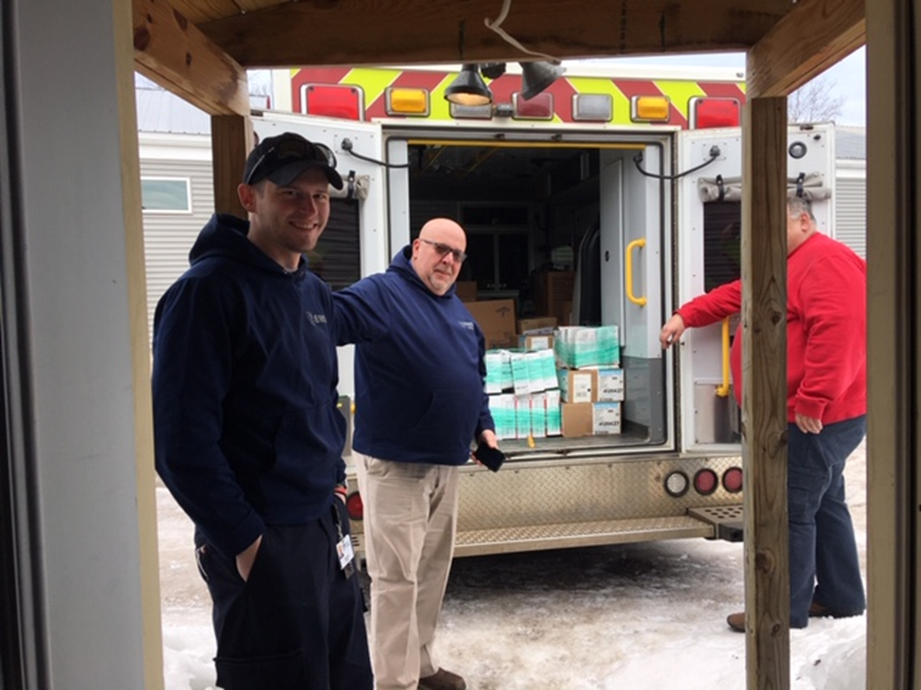
Curt LeSage and Staff –UPHS MQT EMS

Slide 20
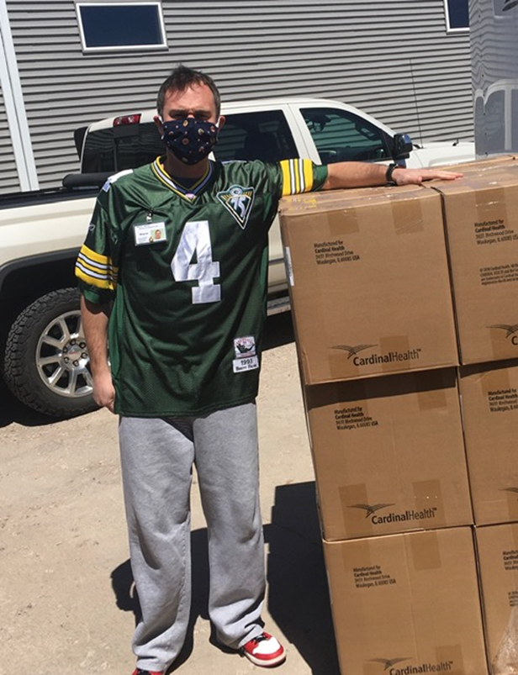
Wayne Johnson – Administrator Norlite Nursing Center
Picking up PPE Supplies

Slide 21
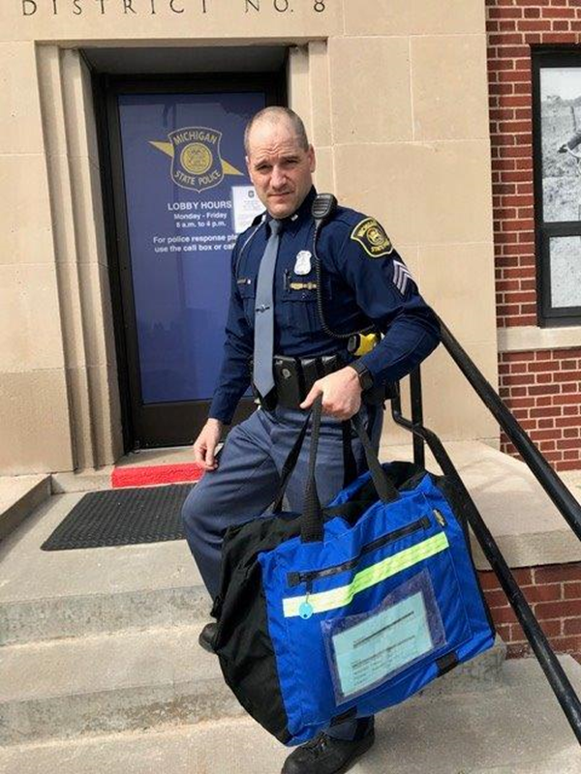
MSP Gladstone Trooper with Medication Relay from Region 8 to Detroit

Slide 22


Slide 23
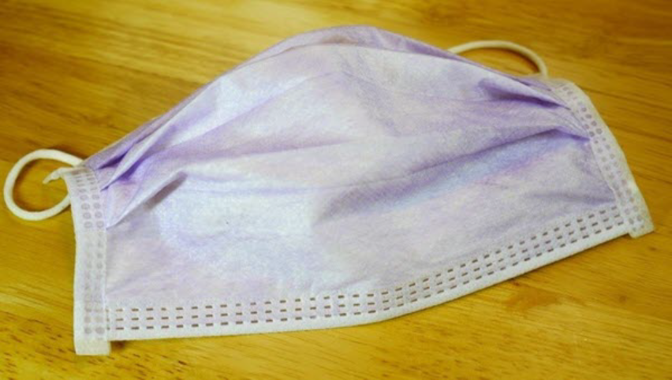
What are these used for???

Slide 24
IMMEDIATE RELEASE - July 20, 2020
MEDIA CONTACT ONLY:
Kerry Ott, Public Information Officer
LMAS District Health Department
906-341-6951 x112 or 906-630-4511 kott@lmasdhd.org
LMAS District Health Department - Free COVID-19 National Guard Testing Sites
Free Coronavirus testing will be offered in St. Ignace on Friday July 24th, and Newberry on Saturday July 25th. The free testing is being offered by the Michigan National Guard in partnership with LMAS District Health Department, Michigan State Police, Mackinac Straits Health System, Helen Newberry Joy Hospital, the Sault Ste. Marie Tribe of Chippewa Indians, Luce County Road Commission, St. Ignace Area Schools, Luce County Sheriff’s Office, Mackinac County Sheriff’s Office, and Emergency Management in Mackinac and Luce.
Free

Slide 25
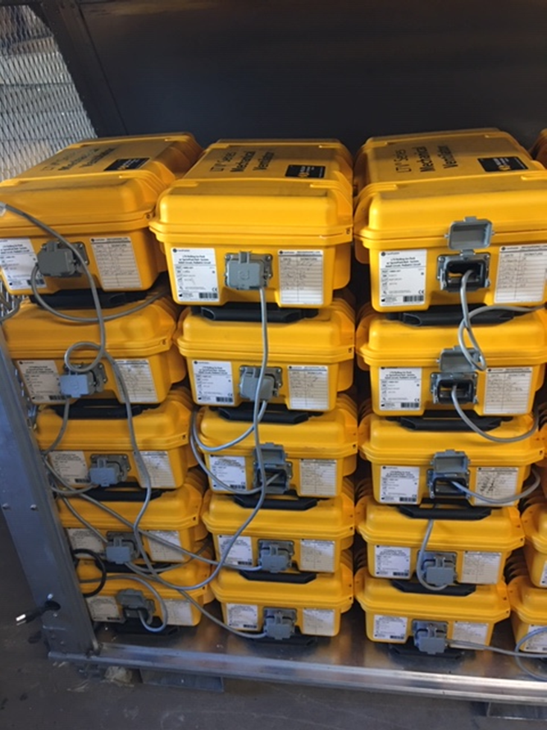
Ventilator Cache from FEMA

Slide 26
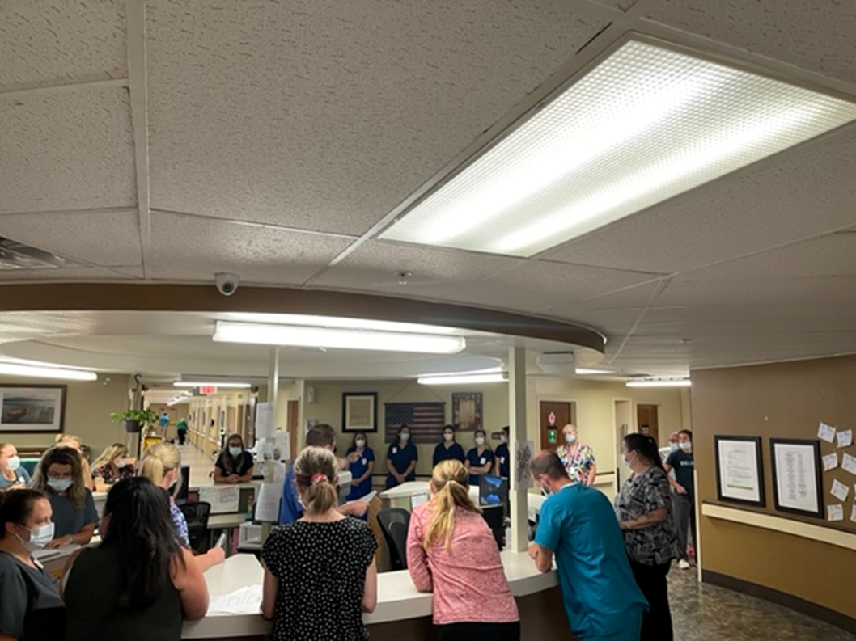
Christian Park Healthcare Center/Christian Park Village Evacuation Exercise

Slide 27
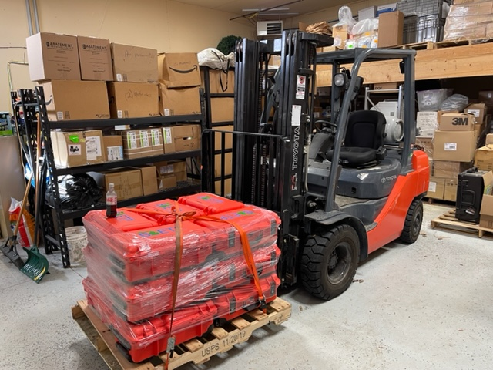
State Provided LTV1200 Ventilators to Supplement Cache

Slide 28
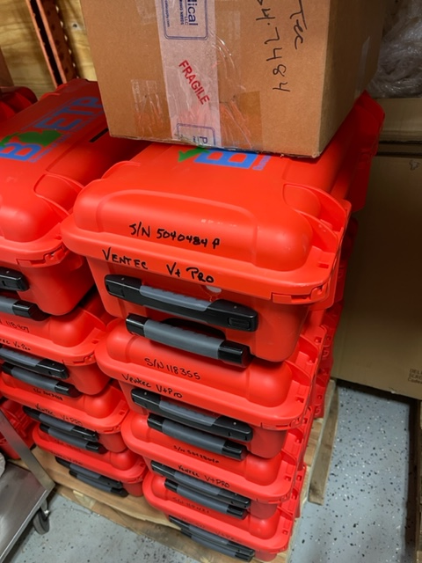
State Supplied VenTec Ventilators

Slide 29
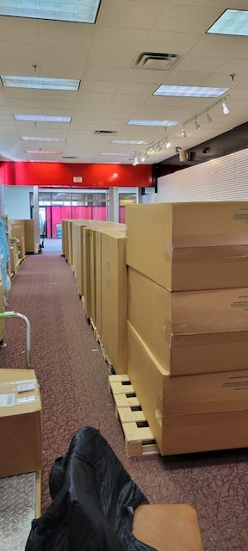
Isolation Carts –Marquette HUB

Slide 30


Slide 31


Slide 32
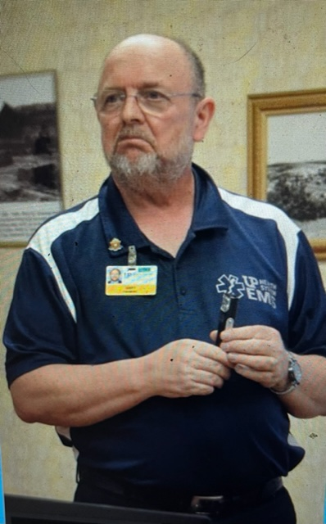
Don’t Ask

Slide 33
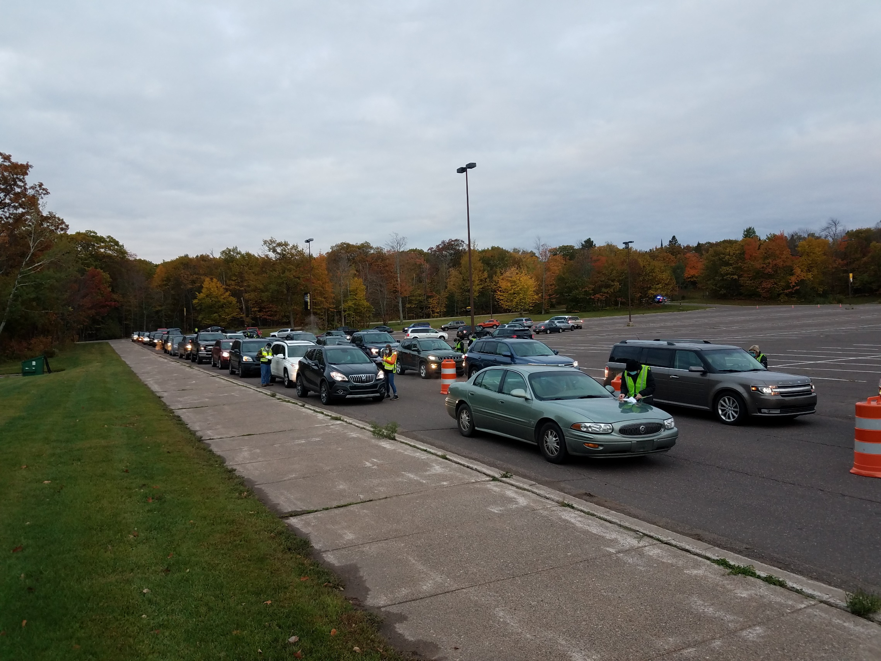
Western UP Health Department COVID Testing

Slide 34
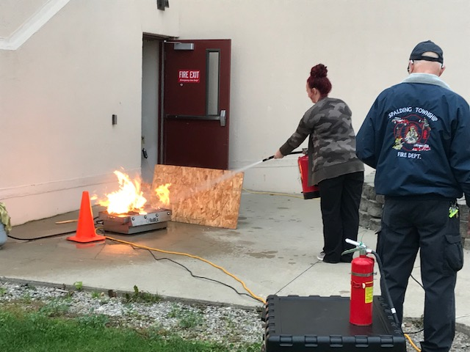
Fire Extinguisher Training – Pinecrest

Slide 35
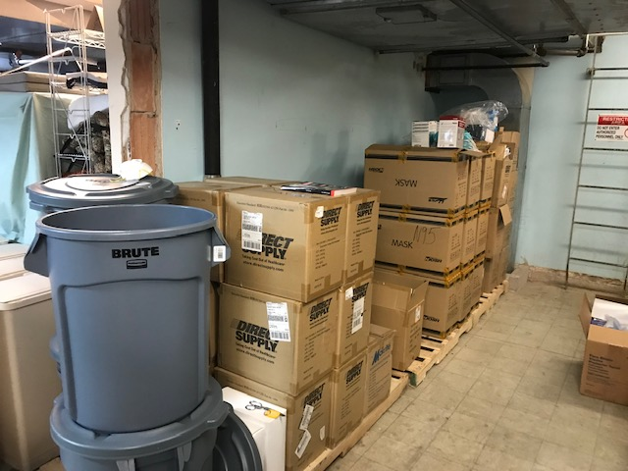
Pinecrest PPE Cache

Slide 36
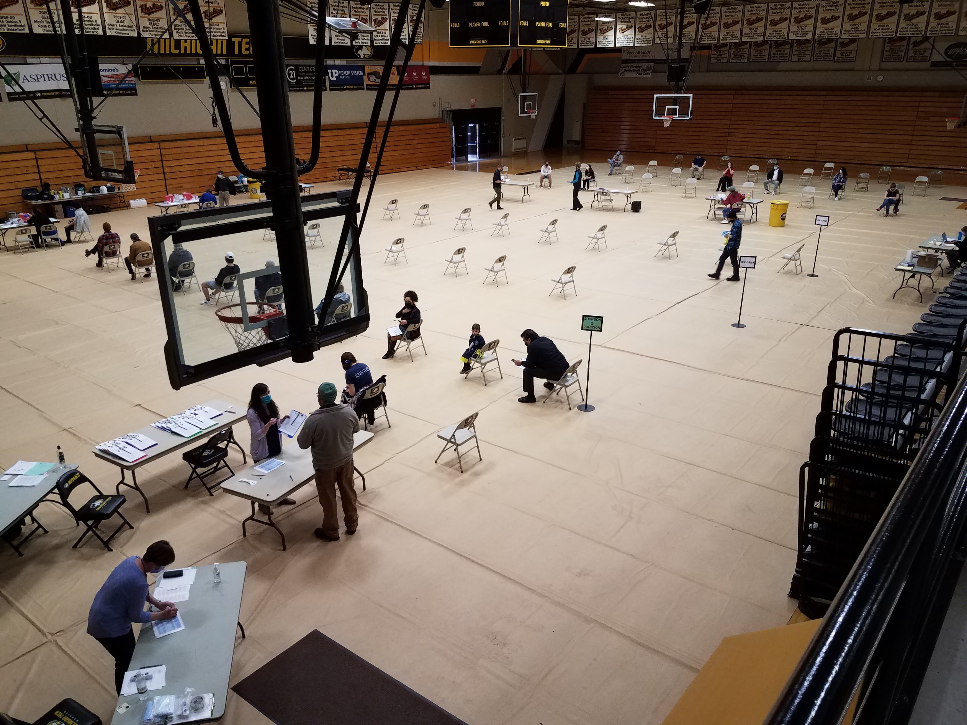
WUPHD

Slide 37
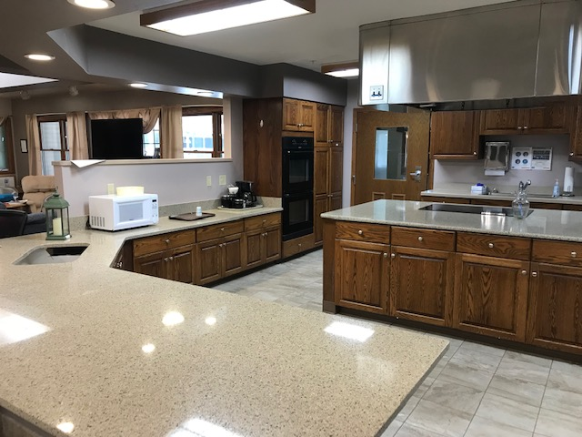
Staffing Shortages

Slide 38

Average Healthcare Provider

Slide 39
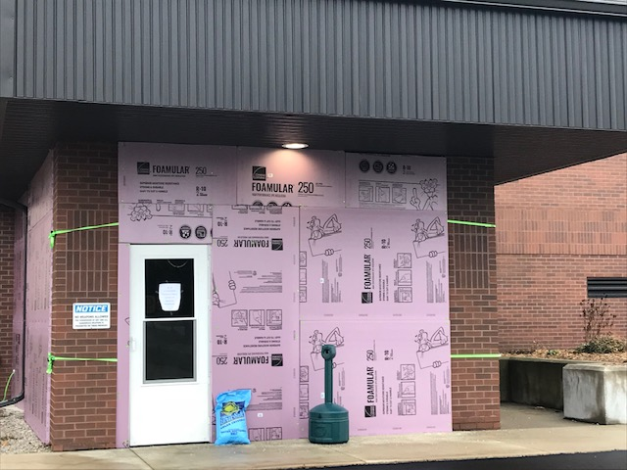
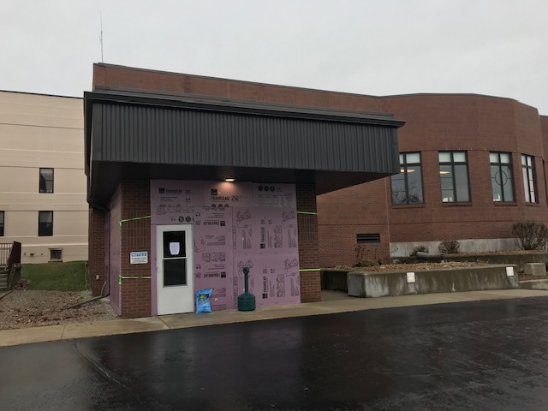
Outside Visiting Area by Entrance to Pinecrest……..

Slide 40
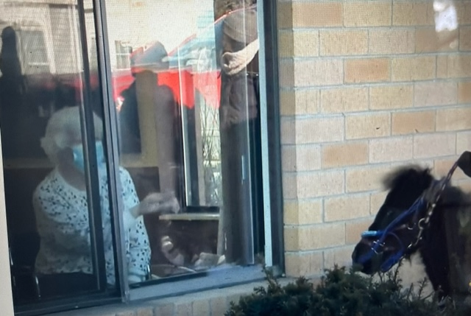
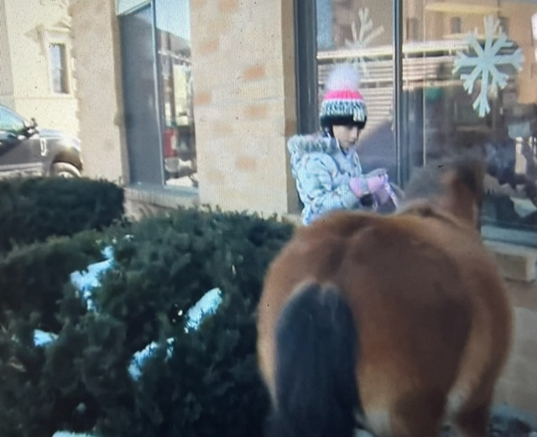
Menominee Health Services: Horses –
A Window to the Heart

Slide 41
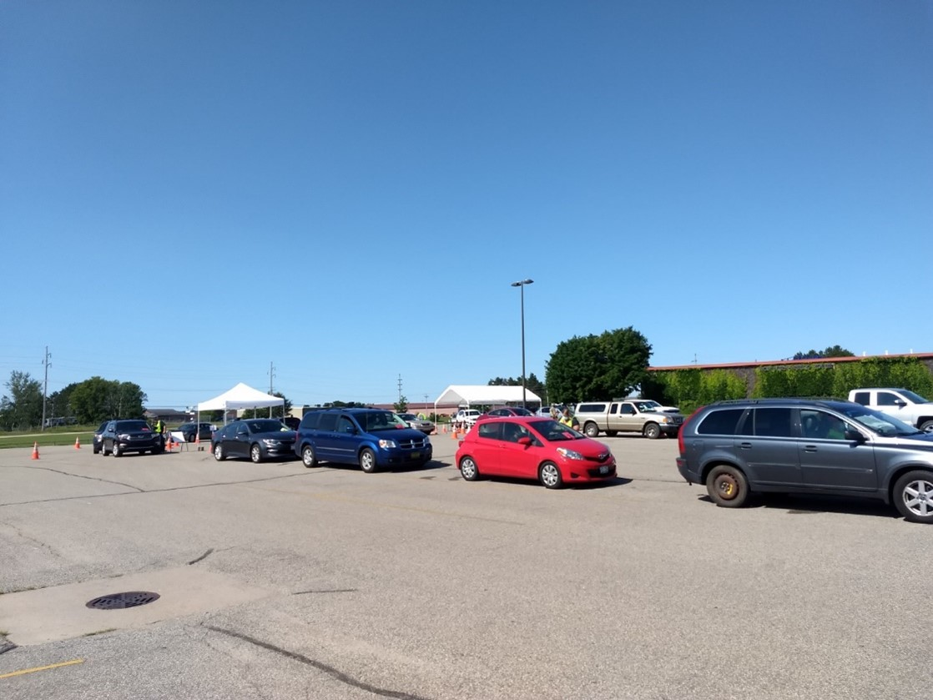
Dickinson-Iron County Public Health
COVID Testing

Slide 42
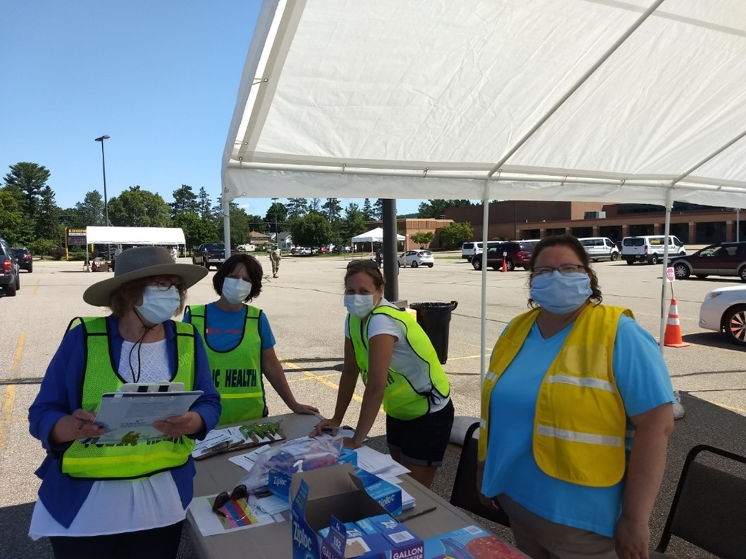
Drive Through Testing

Slide 43
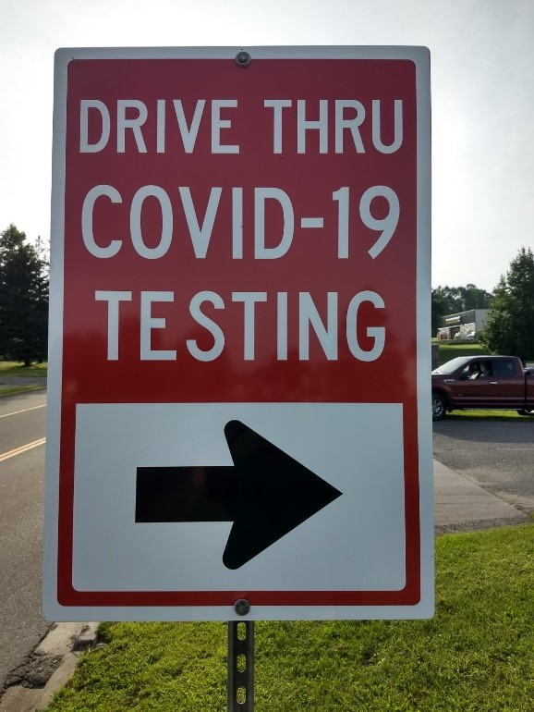
Drive Through Testing

Slide 44
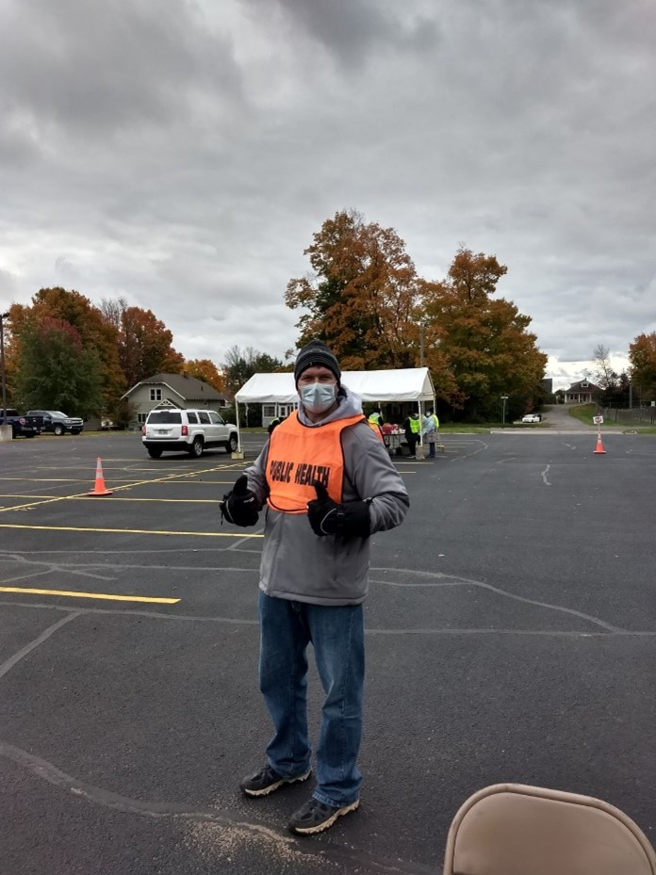

Slide 45
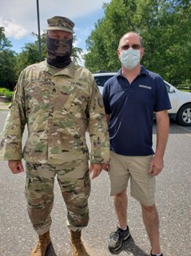

Slide 46
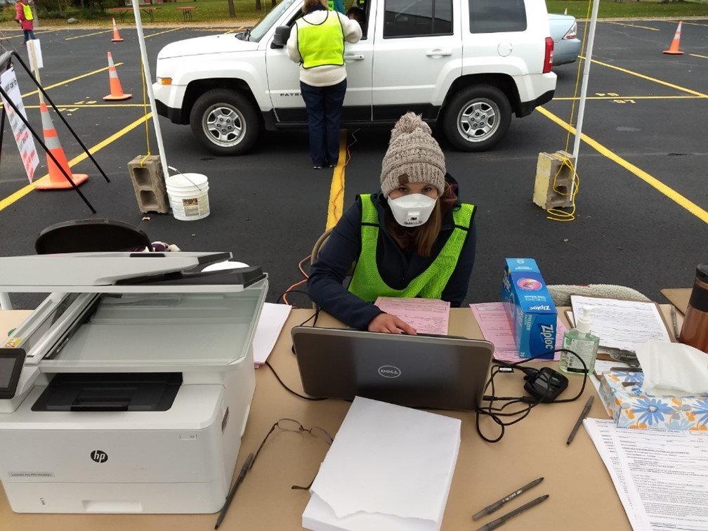

Slide 47
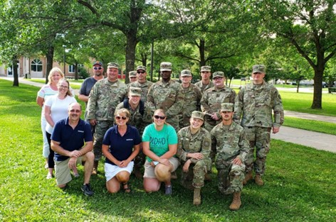
DICHD/National Guard

Slide 48
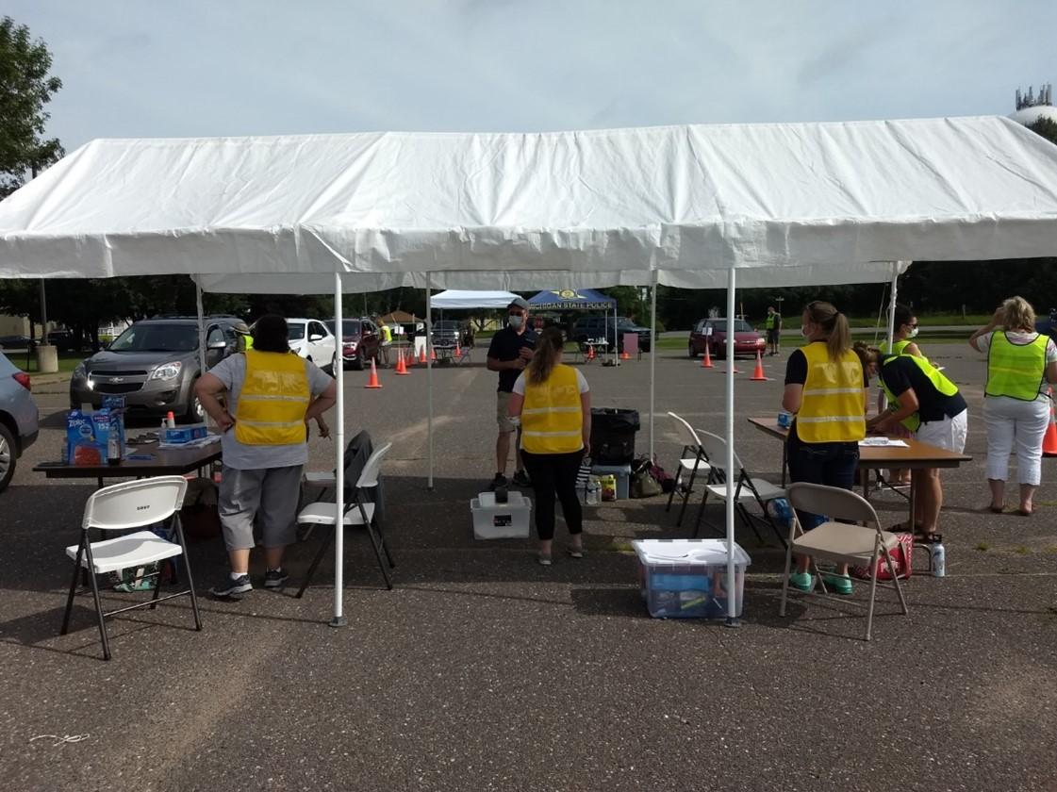
Dickinson-Iron County Health Department Covid Testing

Slide 49
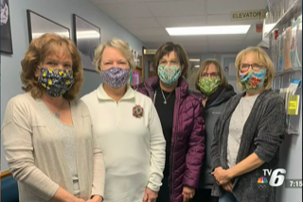
Priceless Volunteers

Slide 50
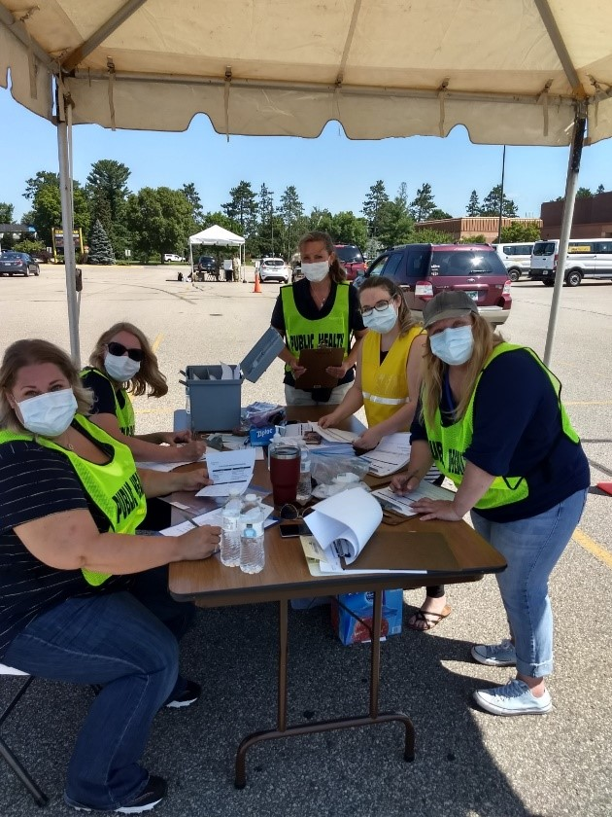
Dickinson-Iron Public Health Covid Clinic

Slide 51
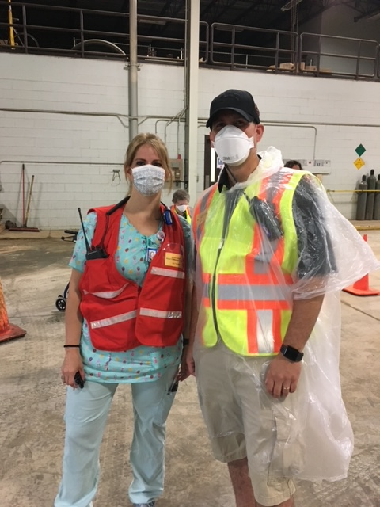
Alger County Covid Clinic

Slide 52
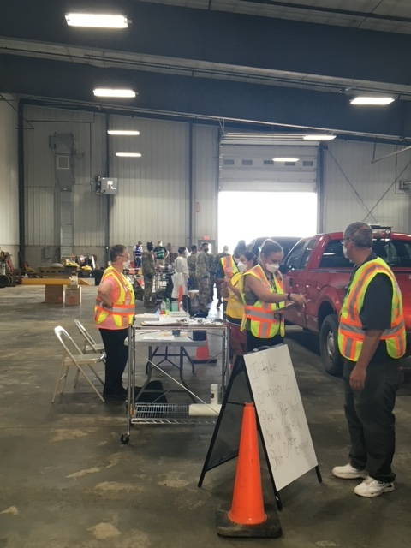
Luce County Road Commission

Slide 53
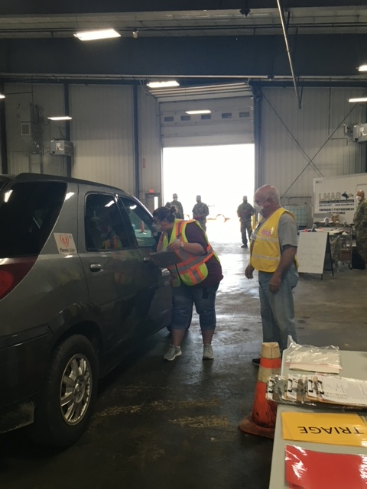
Luce County Road Commission

Slide 54
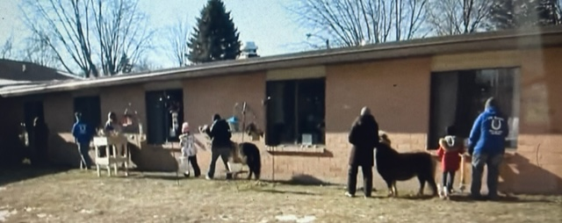
Menominee Health Services

Slide 55

Menominee Health Services

Slide 56


Slide 57

Guardian Flight

Slide 58


Slide 59

FEMA Ventilators Arrive

Slide 60

Ray Johnson, NHA Eastwood Nursing Center
Teresa Schwalbach, MQT CO EM
Covid Evacuation Exercise

Slide 61


Slide 62

WUPHD

Slide 63



Slide 64
Thank You!!
Region 8

